Slide 1
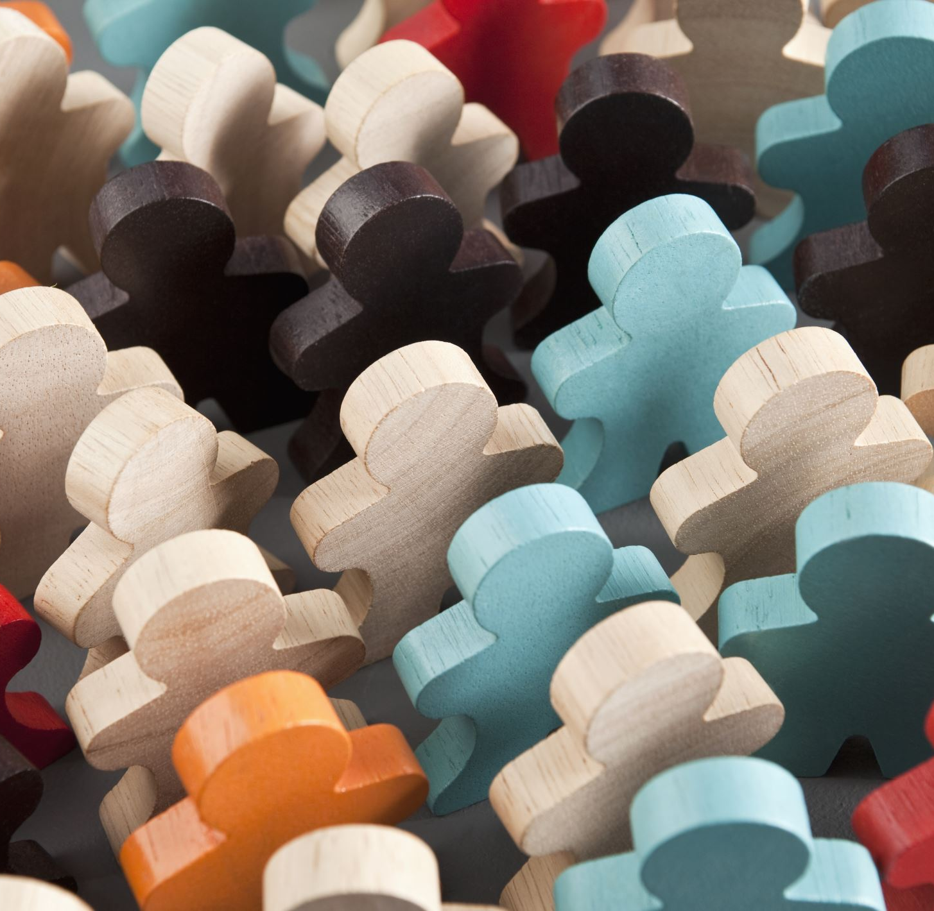
Mutual respect
By Chriselda Amoako

Slide 2
What is mutual respect? Mutual respect is understanding that not everyone has the same beliefs

